Slide 1
Is it time to invest in our public transportation system?
A look into how Nashville compares with its peers.
Notes:
I did my capstone on the public transportation system and how Nashville compares with its peers.

Slide 2
Goals
To evaluate if Nashville needs to invest more into public transportation.
Compare Nashville to some of its peers.
A view into what Nashville could look like in the future.

Slide 3
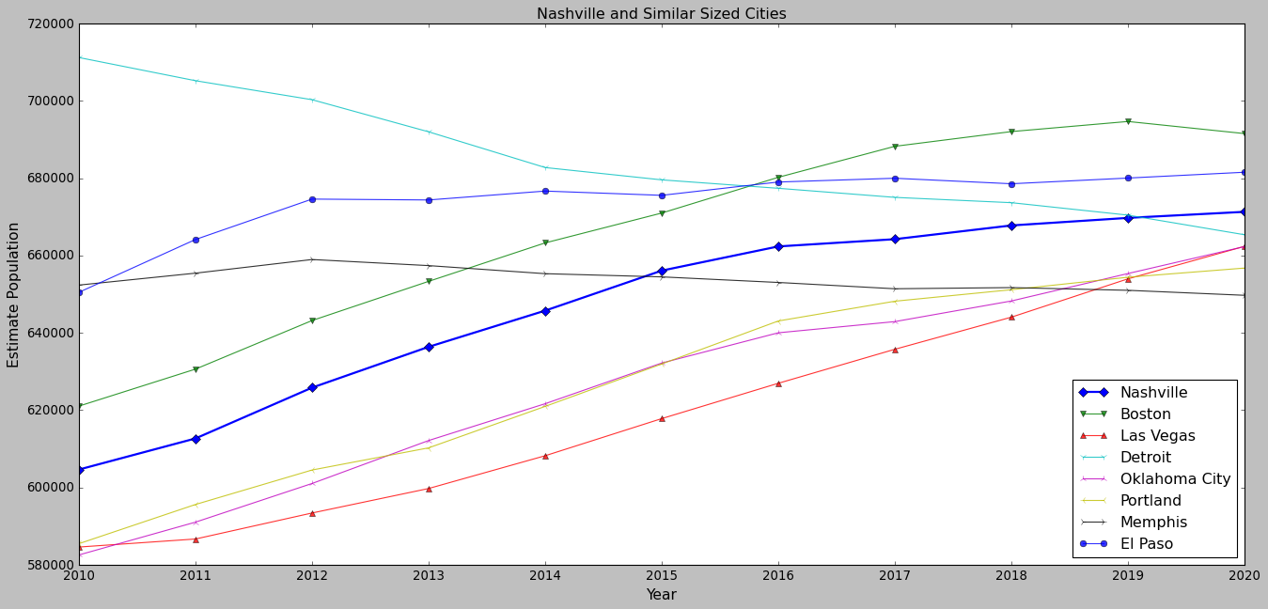
Similar Sized Cities to Nashville
Notes:
On this slide, we are taking a look at Nashville’s population growth over the last decade. Represented by the blue line with the diamond markers.
I then took Nashville’s population in 2020 and plotted some cities with similar sized populatiosn. The range I chose was +- 5% Nashville’s population.
This range was arbitrarily chosen but it gave me a good number of neighboring cities.
One thing to note is some of the trajectories of these cities. While the majority are on an upward trend, cities such as Detroit and Memphis are going in the opposite direction.
Before we take a look at the cities public transportation, I want to notate a couple of benefits from public transportation.

Slide 4
Benefits of public transportation
Reduces air pollution
Increases mobility
Encourages healthier habits
Reduced traffic congestion
Notes:
These are only some of the benefits that you would get with public transportation.
Air pollution - We all remember COVID lockdown and you could notice the better air quality due to less cars.
Mobility - As the city grows, places to live get more scarce. We need to invest in public transportation to increase that mobility
Healthier habits - having a good network of public transportation encourages more people to walk and stay active
Reduced traffic congestion - As we walk through the next couple of slides, keep this one in mind.

Slide 5
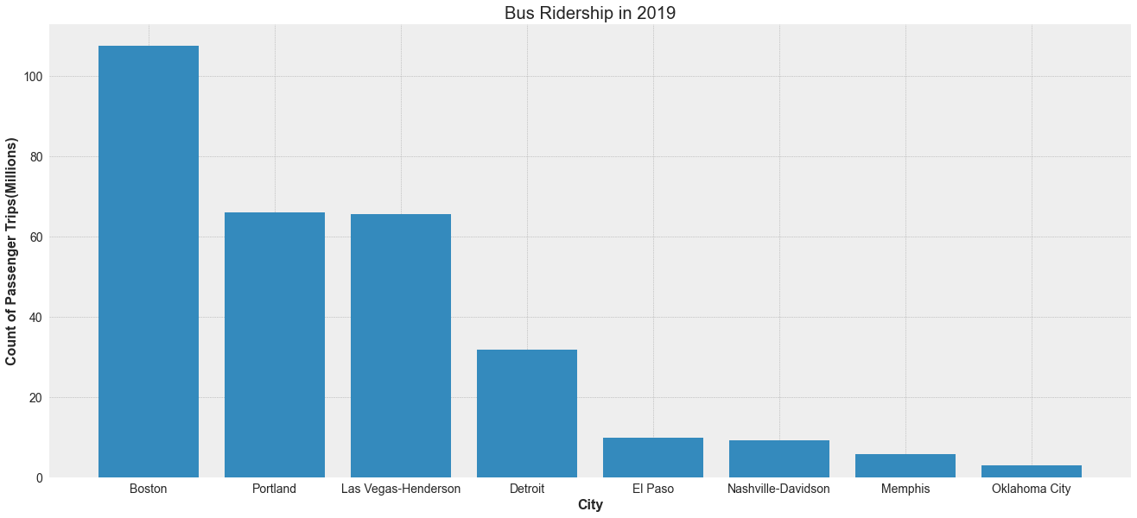
Looking at the most common mode of public transportation.
Notes:
So the first mode of transportation I wanted to look at was buses. They are the most simple and most common across all cities.
As you can see, Nashville’s ridership is not too high. These cities all have relatively the same population yet some have 5-10x more bus riders.
I then wanted to see what everyone’s overall ridership looked like.

Slide 6
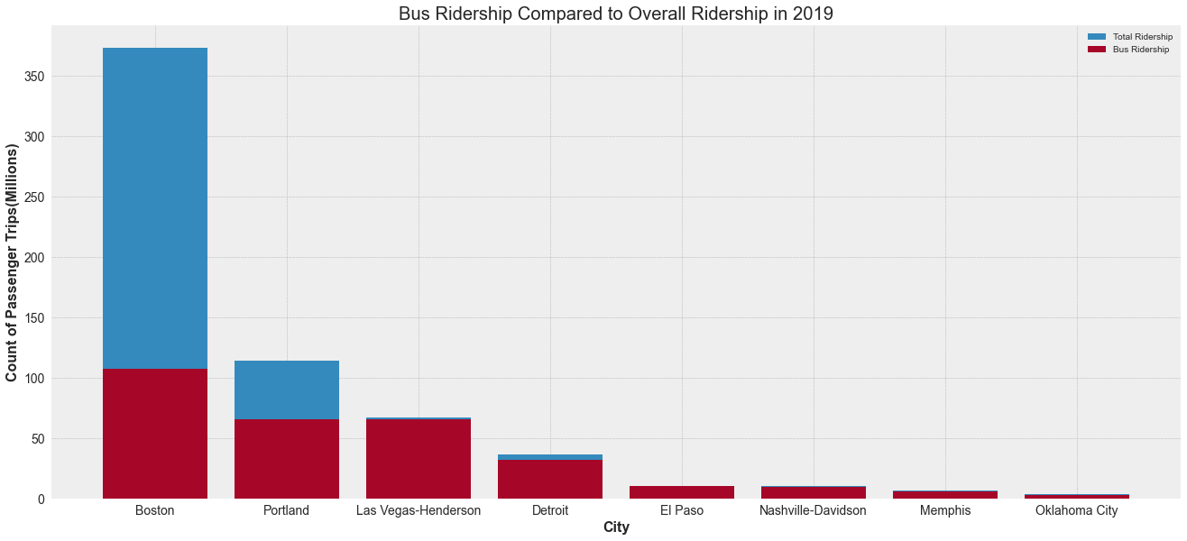
Bus Ridership vs Overall
Notes:
On this graph, I’ve plotted the overall ridership for these cities across all modes of public transportation.
I have also included how much of it is from buses, which is shaded in red.
Please note that the majority of public transportation is made up of buses.
It is interesting to see Boston’s numbers. Only about 30% of their ridership is attributed to buses. The majority of it looks to be something else, and I wanted to check what it was.

Slide 7
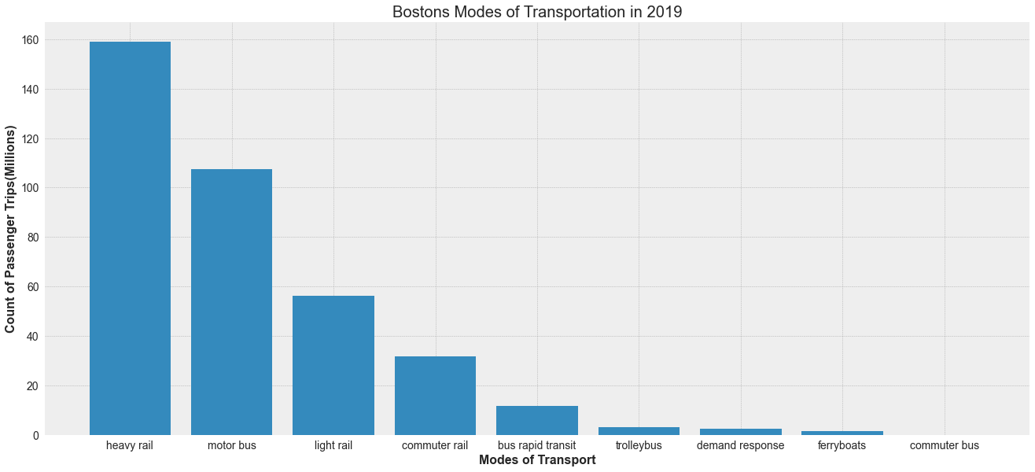
Boston’s Modes of Transportation
Notes:
So this is a breakdown of Boston’s modes of transportation. You can see that the bus is ranked 2nd in ridership.
But the majority of Boston’s ridership is on some kind of rail system. Ultimately, I would like Nashville to head in this direction as we grow.
Rail systems are efficient, just imagine a train compared to a bus. Trains have the capacity to move hundreds of people while buses are at most able to move 30-40.
The major obstacle to these nice rail systems are the costs.

Slide 8
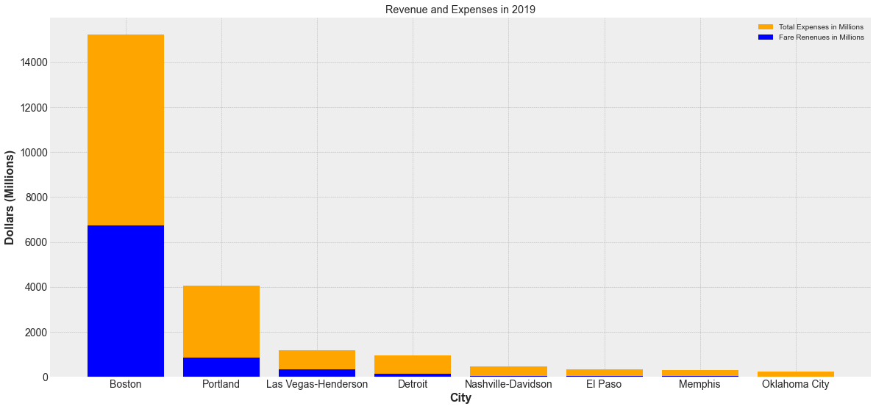
Revenue and Cost Breakdown
Notes:
This is a breakdown of the total operating expenses(shaded in orange) and the fare revenues(shaded in blue).
The operating expense is much much higher in the cities that have rail systems, but we need to change our viewpoint.
These expenses need to be viewed as an investment back into these respective cities. The are investing this money into the public transportation system in order to get those benefits we list earlier.
Now the next couple of slides are a look into the future.

Slide 9
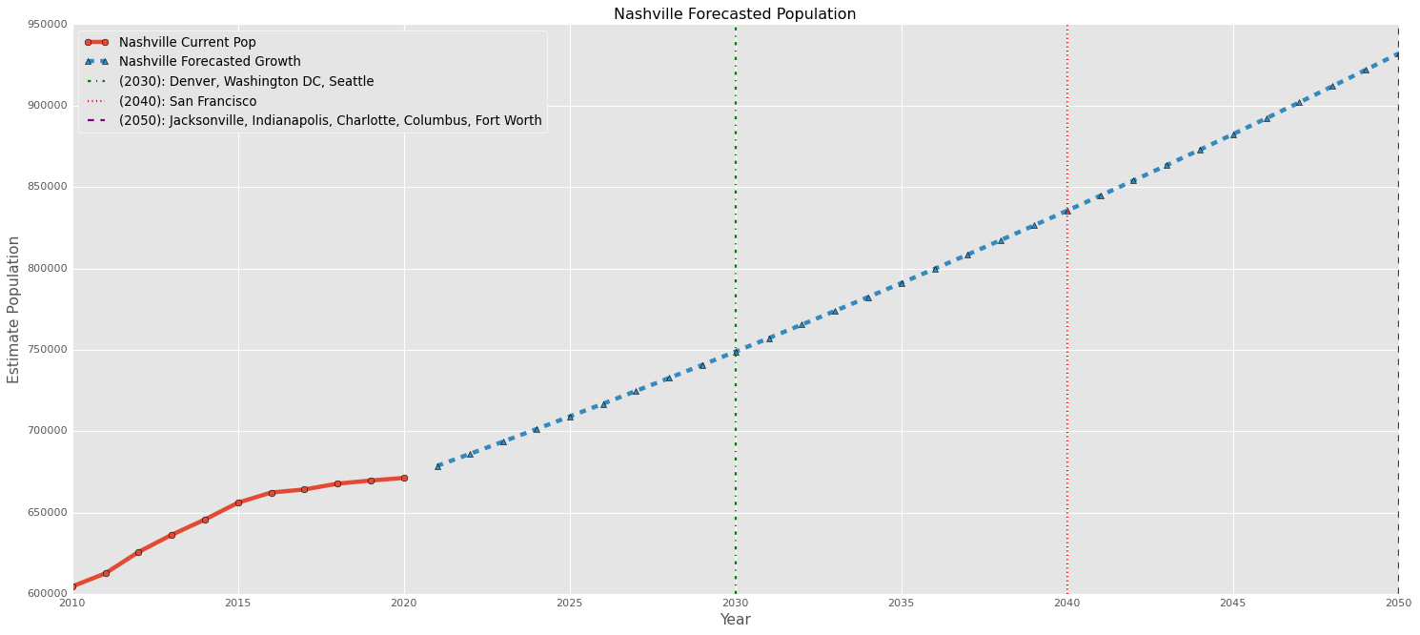
Nashville’s Forecasted Growth
Notes:
This is another population graph.
In this graph, I have taken Nashville’s growth over the last decade. I’ve calculated the percent growth which was about 1% average a year. Then I applied that 1% over the next 30 years.
I’ve placed markers at each decade, and if you look at the legend in the top left hand corner, I’ve listed cities that currently have that population.
So by 2030, Nashville will be as large as Denver, Washington DC, and Seattle.

Slide 10
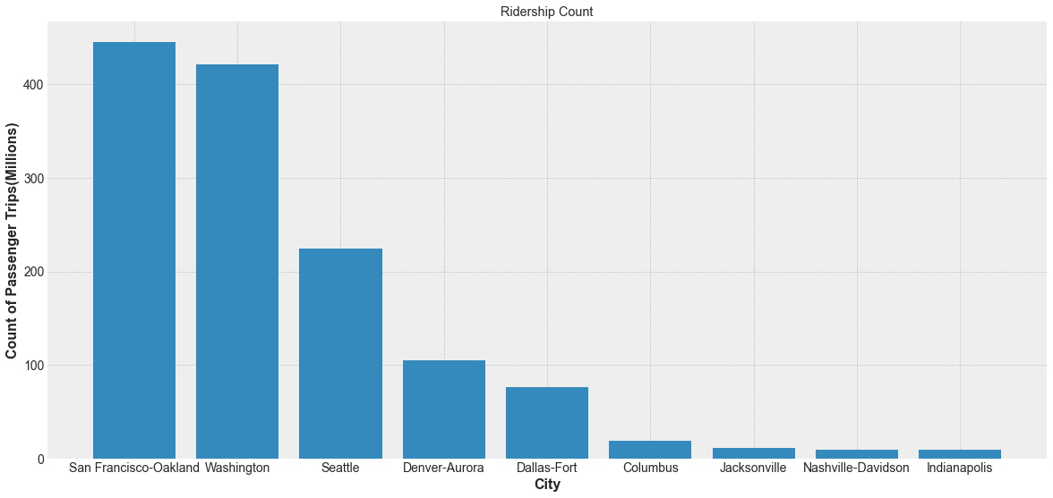
Future Ridership
Notes:
As your population grows, your need for more public transportation increases.

Slide 11
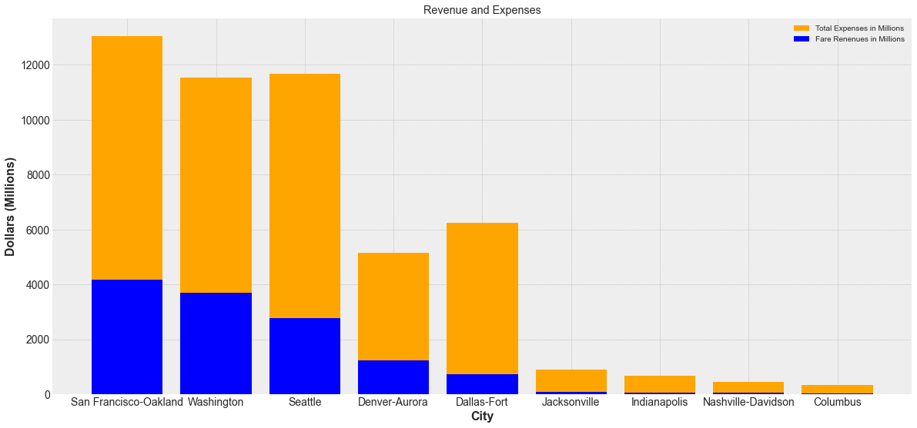
Future Revenue and Expenses
Notes:
This graph, the cities at the bottom are ordered the same way as the previous graph.
One interesting thing to note here, is that Dallas spends more on their public transportation but has a lower ridership.
Seattle also spends a little more than DC but Seattle’s ridership is much lower.

Slide 12
Tableau Dashboard
https://public.tableau.com/views/Public_Transportation_Ridership/Dashboard1?:language=en-US&:display_count=n&:origin=viz_share_link

